Slide 1
Predicting Telcom Customer Churn
Submitted by: Aditi Gupta

Slide 2
Predicting Telcom Customer Churn
What is customer churn?
Problem Statement
Context
Exploratory Data Analysis
Preprocessing and Training
Modelling and Model Evaluation
Appendix: Columns and definitions

Slide 3
What is customer churn?
Customer churn is defined as when customers or subscribers discontinue doing business with a firm or service.

Slide 4
Problem Statement
JB link telco company is encountering a problem of a high 27% customer loss leading to a 12% drop in our customer numbers. And urgently need to forecast which customers are prone to churn and recommend tailored strategies to retain customers.

Slide 5
Context
Customer churn is a critical challenge faced by the telecom industry. As customers switch from one service provider to another, telecom companies experience revenue loss and increased customer acquisition costs. To address this issue, we embarked on a project to develop machine learning models that can predict the likelihood of customer churn.
Gather insights from the data to understand what is driving the high customer churn rate.
Develop a Machine Learning model that can accurately predict the customers that are more likely to churn.
Prescribe customized actions that could be taken to retain each of those customers.

Slide 6
Exploratory Data Analysis

Slide 7
Contract Type
Customers with month-to-month contracts have a significantly higher churn rate. Approximately 54% of customers with month-to-month contracts churned, compared to only 11% with one-year contracts and 3% with two-year contracts.

Slide 8
Customer Satisfaction
Customers with satisfaction scores below 3 are more likely to churn. Visualization of customer satisfaction distribution highlighted that lower scores correlate with higher churn.

Slide 9
Internet Type
Customers with cable or DSL services show higher churn rates compared to those with fiber optic services. This insight suggests that service quality differences impact customer retention.

Slide 10
Geographic Analysis
Los Angeles has the highest number of customers, but San Diego has the highest number of churned customers, with many citing better offers from competitors. This indicates a regional disparity in competitive pressure and customer retention.

Slide 11
PREPROCESSING AND TRAINING

Slide 12
Customer Statistics
Feature Selection: Removed unnecessary columns and retained features with significant correlation to churn. Created a correlation matrix to identify these features, setting a threshold of 0.2.
Data Transformation: Converted categorical variables into numerical ones using one-hot encoding.
Data Splitting: Split the data into training (80%) and testing (20%) sets to prepare for model training and evaluation.

Slide 13
Modelling and Model Evaluation

Slide 14
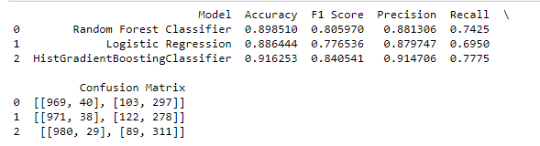
Potential customers who are most likely to churn
Goal: Main goal was to identify the potential customers who are most likely to churn.
I evaluated three models and after comparing Logistic Regression, Random Forest Classifier and HistGradientBoostingClassifier models, I select the best-model based on a good balance between all the measuring.

Slide 15
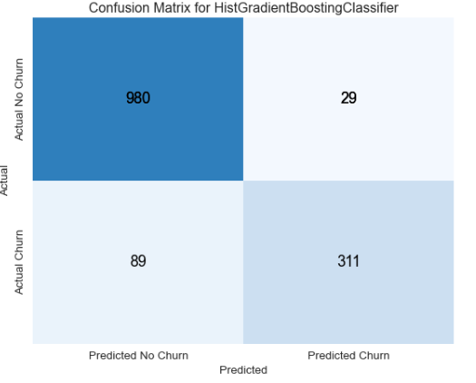
Confusion Matrix
High True Positives and True Negatives: The model correctly identified a large number of both churned and non-churned customers.
Low False Negatives: Only 29 false negatives, indicating that the model missed few actual churn cases.
Moderate False Positives: 89 false positives, which is manageable but indicates some over-prediction of churn.

Slide 16
Appendix: Columns and definitions

Slide 17
Column Name | Description
Churn Value | 1 = the customer left the company this quarter. 0 = the customer remained with the company
Customer ID | A unique ID that identifies each customer
Referred a Friend | Indicates if the customer has ever referred a friend or family member to this company
Number of Referrals | Indicates the number of referrals to date that the customer has made
Tenure in Months | Indicates the total amount of months that the customer has been with the company by the end of the quarter specified
Offer | Identifies the last marketing offer that the customer accepted, if applicable
Phone Service | Indicates if the customer subscribes to home phone service with the company
Avg Monthly Long-Distance Charges | Indicates the customer’s average long-distance charges, calculated to the end of the quarter
Multiple Lines | Indicates if the customer subscribes to multiple telephone lines with the company
Internet Service | Indicates if the customer subscribes to Internet service with the company
Internet Type | Indicates the type of Internet service the customer subscribes

Slide 18
Column Name | Description
Avg Monthly GB Download | Indicates the customer’s average download volume in gigabytes, calculated to the end of the quarter
Online Security | Indicates if the customer subscribes to an additional online security service provided by the company
Online Backup | Indicates if the customer subscribes to an additional online backup service provided by the company
Device Protection Plan | Indicates if the customer subscribes to an additional device protection plan for their Internet equipment
Premium Tech Support | Indicates if the customer subscribes to an additional technical support plan from the company with reduced
Streaming TV | Indicates if the customer uses their Internet service to stream television programing from a third-party provider
Streaming Movies | Indicates if the customer uses their Internet service to stream movies from a third-party provider
Streaming Music | Indicates if the customer uses their Internet service to stream music from a third-party provider
Unlimited Data | Indicates if the customer has paid an additional monthly fee to have unlimited data downloads/uploads
Contract | Indicates the customer’s current contract type
Paperless Billing | Indicates if the customer has chosen paperless billing
Payment Method | Indicates how the customer pays their bill

Slide 19
Column Name | Description
Monthly Charge | Indicates the customer’s current total monthly charge for all their services from the company
Total Regular Charges | Indicates the customer’s total regular charges, excluding additional charges
Total Refunds | Indicates the customer’s total refunds
Total Extra Data Charges | Indicates the customer’s total charges for extra data downloads above those specified in their plan
Total Long Distance Charges | Indicates the customer’s total charges for long distance above those specified in their plan
Gender | The customer's gender
Age | The customer’s current age
Under 30 | Indicates if the customer is under 30 years old
Senior Citizen | Indicates if the customer is 65 or older
Married | Indicates if the customer is married
Dependents | Indicates if the customer lives with any dependents: Yes, No. Dependents could be children, parents, grandparents, etc.
Number of Dependents | Indicates the number of dependents that live with the customer

Slide 20
Column Name | Description
City | The city of the customer’s primary residence
Zip Code | The zip code of the customer’s primary residence
Latitude | The latitude of the customer’s primary residence
Longitude | The longitude of the customer’s primary residence
Population | A current population estimate for the entire Zip Code area
CLTV | Customer Lifetime Value. A predicted CLTV is calculated using corporate formulas and existing data. The higher the value, the more valuable the customer
Churn Category | A high-level category for the customer’s reason for churning
Churn Reason | A customer’s specific reason for leaving the company
Total Customer Svc Requests | Number of times the customer contacted customer service in the past quarter
Product/Service Issues Reported | Number of times the customer reported an issue with a product or service in the past quarter
Customer Satisfaction | A customer’s overall satisfaction rating of the company from 1 (Very Unsatisfied) to 5 (Very Satisfied) collected on customer service requests

Slide 21
Thank you!

